Slide 1




NCIT Webinar Series
Unlocking the Future: How the IIJA is Impacting the U.S. Transportation Construction Market
Alison Premo Black, PhD
Senior Vice President & Chief Economist
American Road & Transportation Builders Association (ARTBA)
Date: Oct. 8, 2024
Time: 1:30 p.m. (CDT)

Slide 2





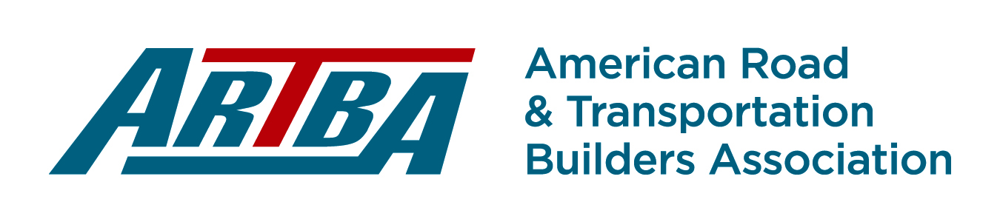
U.S. Highway & Bridge Construction Market Pipeline
Federal & State Funding
State
Budgets
Contract Awards
Construction Activity
Materials Demand

Slide 3
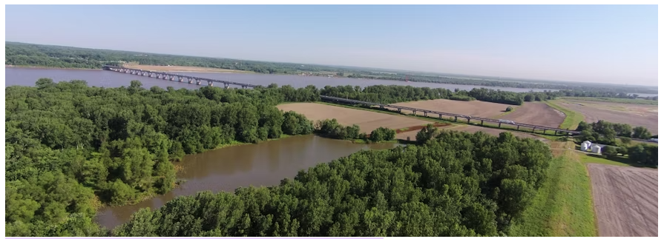
New I-270 Mississippi River Chain of Rocks Bridge
Expand Lanes on New Bridge, New Diverging Diamond Interchange
July 2022:
The project is advertised and goes out to bid.
Walsh Construction bids $496 million and receives the
contract award.
Sep. 2022:
Illinois DOT commits $198 million in federal aid highway funds
to the project.
March 2023 to 2025:
On-site construction work is expected to go through 2025.
As work is completed, Illinois pays Walsh Construction with state funds and requests reimbursement from the U.S. Treasury for the federal share of the project.
Project outlays from the state to the contractor and federal-aid reimbursements to Illinois continue until the project is complete.
The bridge, opened in 1966, connects St. Louis and Madison County, Illinois. The new bridge will open as four lanes and eventually will carry six lanes after I-270 east and west are widened..
Source: Photo from Illinois DOT

Slide 4
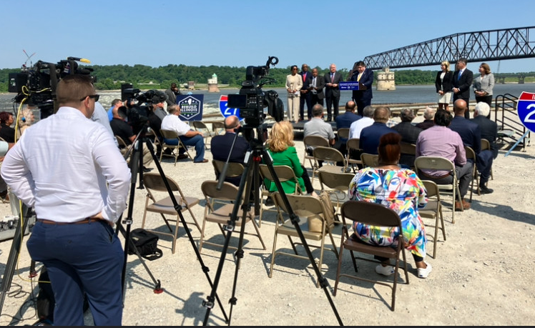
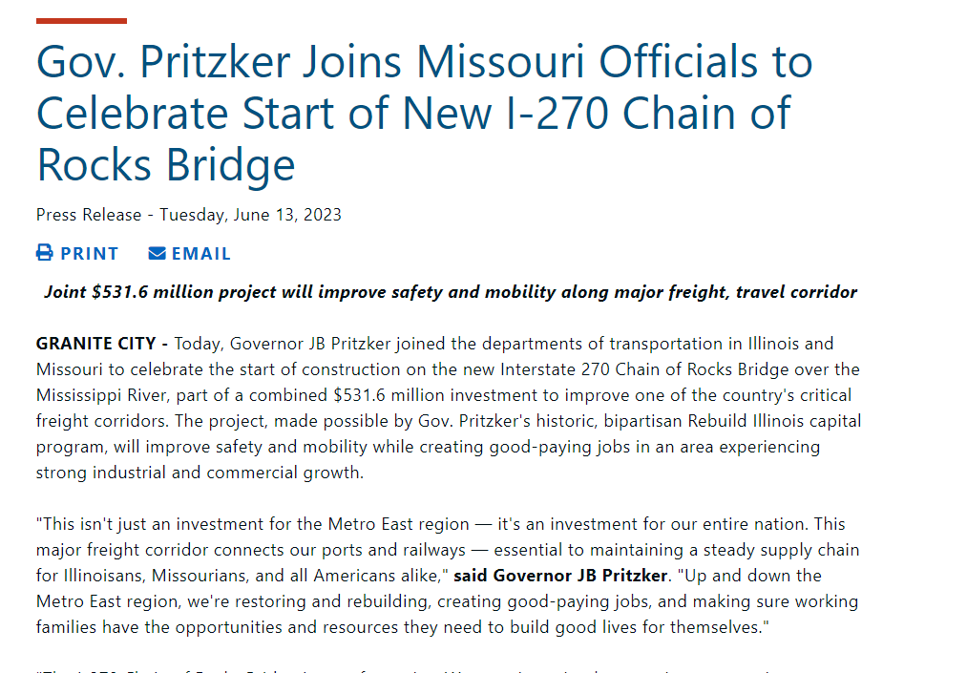
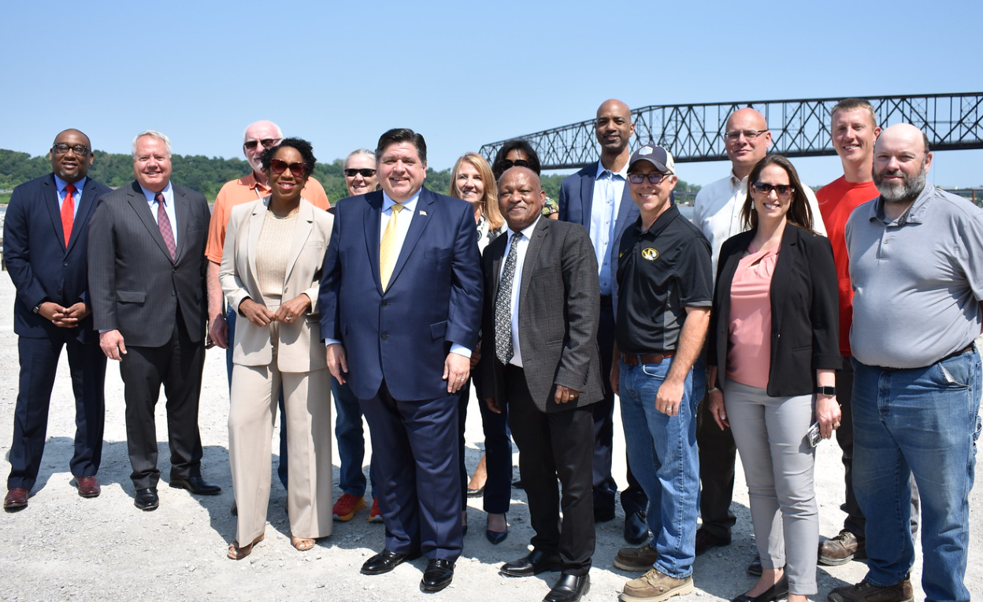
New I-270 Mississippi River Chain of Rocks Bridge
Expand Lanes on New Bridge, New Diverging Diamond Interchange
Source: Photos from Illinois DOT

Slide 5

Federal funds, on average, provided 54% of annual state DOT capital outlays
for state administered highway & bridge projects in FY 2022, up from 52% in FY 2021
59%
NH
74%
Over 69% of state highway & bridge capital outlays
47%
Over 80%
57%
58%
72%
56%
50 to 69% of state highway & bridge capital outlays
VT
Over 80%
72%
45%
Over 80%
64%
58%
26 to 49% of state highway & bridge capital outlays
74%
MA
64%
44%
38%
55%
30%
70%
38%
78%
70%
58%
40%
CT
49%
RI
Over 80%
44%
Over
80%
61%
67%
DE
51%
NJ
39%
Over 80%
Over 80%
27%
48%
78%
42%
52%
52%
MD
44%
DC
49%
76%
67%
73%
Over
80%
72%
26%
HI, Over
80%
Source: ARTBA analysis of FHWA Highway Statistics data, total for 2022 from tables SF-1 and SF-2. The percent is the ratio of federal aid reimbursements to the state and total state capital outlays and is indicative of the importance of the federal aid program to state capital spending for highways and bridges. Does not include local capital spending or state spending directly on local roads. Federal highway reimbursements are primarily used for capital outlays, including construction, right of way and engineering, but are also used for debt service for GARVEE bonds that may represent capital work performed in a different year.

Slide 6
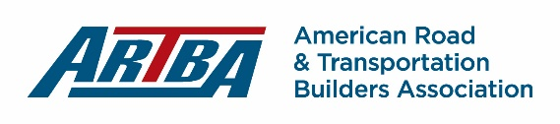

Slide 7
Increase in Federal-Aid Investment Supporting Record Market Growth
Source: FHWA final notices for annual highway program obligations and supplemental programs, Infrastructure Investment & Jobs Act
Notes:
Why the IIJA is important
Record level of investment – growth of 38%
MUST be spent on capital outlays – can’t be used for filling potholes or overhead
Drives half of state spending on highway and bridge construction – lower levels in Florida or some states … other states can be 80%
For market impact … have to understand timing of the project pipeline
What you see here is the money states have to commit to projects … will be spent out over time … many years

Slide 8
U.S. Infrastructure Investment & Jobs Act
Status Report – July 31, 2024
$303.6B
Total IIJA State Allocations FY22-FY26
$178.9B
Funds Available
FY22-FY24
$155.2B
Funds Committed
FY22-YTD FY24
$88.2B
Total IIJA Funds
Reimbursed to States
80k+
Number of New
Project Commitments
Source: Data from U.S. Treasury and the Federal Highway Administration. Project commitments are included if the base year of the award (identified in the U.S. Treasury data) . Does not include COVID relief, emergency, or supplemental funds. FY2022 totals include project commitments made using FAST Act extension funds, to provide a full year on year comparison of total projects supported by the federal aid highway program.

Slide 9
How States Used Federal Funds for New Project Commitments
October 1, 2021 to April 30, 2024
Source: ARTBA analysis of data provided by FHWA. New project commitment is based on the fiscal year the project was approved by FHWA. Does not include obligations of funds for projects that may be ongoing or were approved in previous years.

Slide 10


Percent of IIJA Project Costs for Major Construction
October 1, 2021, through April 30, 2024
80% or more
Of IIJA Project Costs
For Major Const.
70% to 80%
of IIJA Project Costs
for Major Const.
65% to 70%
Of IIJA Project Costs
For Major Const.
65% or Less
of IIJA Project Costs
for Major Const.
Source: Data from the Federal Highway Administration. Project commitments are included if the base year of the award, with type of work identified by the state DOT.
Major construction includes reconstruction work, added capacity, and new construction. Data through April 30, 2024.

Slide 11
Traditional Spend-Out of Federal Highway Funds
Source: U.S. Congressional Budget Office, FHWA

Slide 12
Market Impact of the Increase in IIJA Federal-Aid Highway Investment
Depends on Program Details
  The Infrastructure Investment & Jobs Act (IIJA) provides an average of $70B in annual federal-aid highway program authorizations for FY 2022 to FY 2026, a significant increase from $49B in FY 2021.
  The impact of this additional $21B in new funding depends on specific program details.
  Most core highway formula funds ($9.5B, 45% of average increase) must be committed to projects within the first year of availability.
  States can commit new bridge and electric vehicle formula program funds ($6.5B) over a four-year period.
  Depending on the source of funding, U.S. Department of Transportation (DOT) controlled grants ($5.1B) can take longer to enter the project pipeline.
Source: ARTBA’s IIJA Analysis report, totals may not add up due to rounding and do not include budget authority subject to appropriation from the General Fund. Discretionary programs include project-focused national grants and other programs, such as National Significant Freight & Highway Projects, the Bridge Investment grants and PROTECT discretionary grants.
Notes:
Discretionary: $189 million
$80 Million Mega Grant for I-895 Baltimore Harbor Tunnel Interchange Improvements Projects
December 2020 Public Meeting …
December 2021 Draft Environmental Documents
Spring 2022 Preliminary Engineering
July 2023 Industry Forum … April 2024 Open House
Advertising RFQ … 2026 Design-Build Notice to Proceed
Other RAISE Grants – New Carrollton Multi-modal transportation station project
Revitalize Hanover Street
Penn Station Connections

Slide 13
States Have Committed 48% of Available Bridge Formula Funds as of July 31, 2024
Source: ARTBA analysis of data from Dodge Data Analytics. Includes state and local government contract awards.

Slide 14
US. DOT has Announced $29.6B in Major Discretionary Grants
  U.S. Department of Transportation (DOT) grants under the Infrastructure Investment and Jobs Act (IIJA) account for 13% of total funding under the bill.
  Formula funds account for the remaining 87% of IIJA funding over the five-year period FY 2022 to FY 2026.
  The U.S. DOT has announced $29.6B in highway and bridge grants under major programs.
Source: ARTBA analysis of data provided by U.S. DOT

Slide 15
Traditional Spend-Out of Federal Highway Funds versus Spend-Out of
FY 2022 New Projects
Source: U.S. Congressional Budget Office, ARTBA Analysis of U.S. Treasury Data

Slide 16
Traditional Spend-Out of Federal Highway Funds versus Spend-Out of
FY 2022 New Projects for Reconstruction, New Construction
Source: U.S. Congressional Budget Office, ARTBA Analysis of U.S. Treasury Data

Slide 17
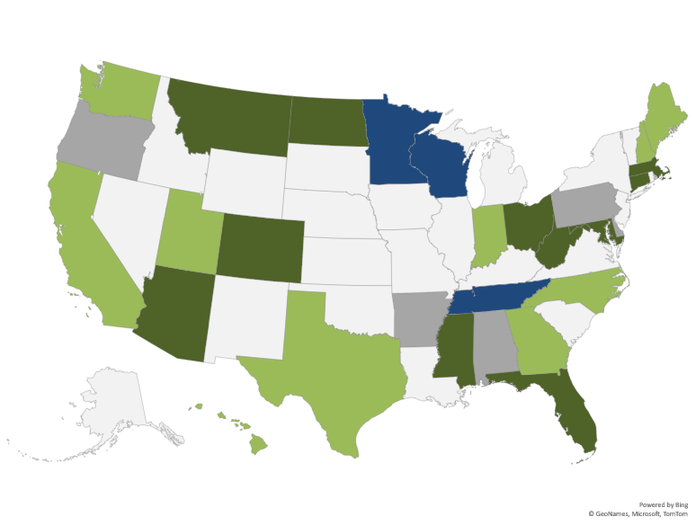
26 States Approved $23 Billion in Transportation-Related Funding Measures in 2023
States With Approved Measures
Source: ARTBA Transportation Infrastructure Advocacy Center

Slide 18
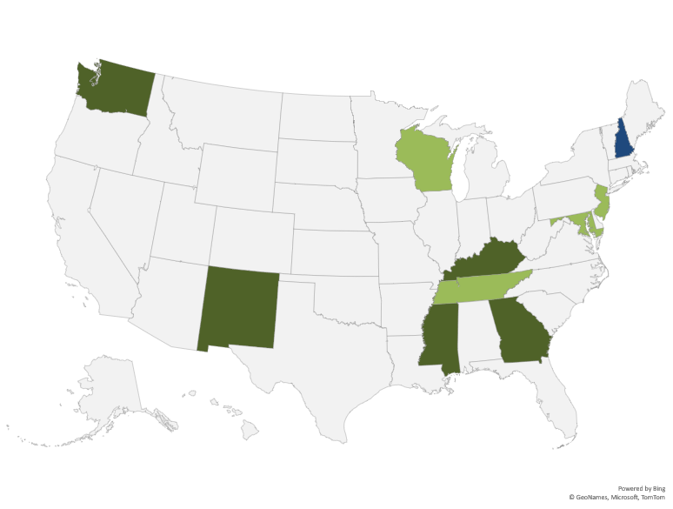
10 States Approved $6.5 Billion in Transportation-Related Funding Measures in 2024
States With Approved Measures
Source: ARTBA Transportation Infrastructure Advocacy Center

Slide 19
State DOT Budget Capacity Leveling Off After Major Increases
Capital spending up by
over one-third (39%)
2021-2024
Source: ARTBA analysis of state legislative budgets and DOT work programs. Some FY 2025 data is preliminary, with totals missing for Wyoming and Oklahoma.
Notes:
Budget Capacity in Maryland … about $3.6 Billion for Consolidated Transportaiton Program
$1.6B in Cpaital …

Slide 20
Value of U.S. State & Local Government Highway & Bridge
Contract Awards through August
Source: ARTBA analysis of data from Dodge Data Analytics

Slide 21
Value of U.S. Highway & Bridge Construction Activity Up 11% through August
Source: ARTBA analysis of data from U.S. Census Bureau, Value of Construction Put in Place

Slide 22
July Employment by
Highway, Street, & Bridge Contractors Employment up 40k Since 2021
Source: U.S Bureau of Labor Statistics, Current Employment Situation

Slide 23
States With Increased Demand for Volume of Asphalt Materials
in State DOT Project Bids, Average for 2022-2023 vs 2021
Source: ARTBA analysis of state DOT bid tab data, weighted index of major asphalt materials. Does not include direct purchases made by DOTs or materials in design-build projects.
Notes:
Major Asphalt Projects:
MD 4 at Suitland Parkway Interchange 90k tons of asphalt
Work on I-95 Capital Beltway in Livingston Road
MD 100 from MD 170 to MD 3
Biggest project: Widening IH-35 in Texas … 7.6 miles work through 2028 awarded in 2022
North Carolina – lots of work in 2022
In 2023:
California – Route 10 in Riverside County
Michigan - $159 million repaving project – 15 miles resurfacing on I-75 (Ajax Paving)
Mississippi: Widening I-10
One of the biggest projects – South Dakota – Interstate 90

Slide 24
States With Increased Demand for Volume of Concrete Materials
in State DOT Project Bids, 2022-2023 Average vs 2021
Source: ARTBA analysis of state DOT bid tab data, weighted index of major cement and concrete materials. Does not include direct purchases made by DOTs or materials in design-build projects.
Notes:
In Maryland –
Suitland Parkway Interchange
Concrete Repairs and Patching in Anne Arundel
Various Districts and Counties
Biggest project: Widening IH-35 in Texas … 7.6 miles work through 2028 awarded in 2022
North Carolina – lots of work in 2022
In 2023:
California – Route 10 in Riverside County
Michigan - $159 million repaving project – 15 miles resurfacing on I-75 (Ajax Paving)
Mississippi: Widening I-10
One of the biggest projects – South Dakota – Interstate 90

Slide 25
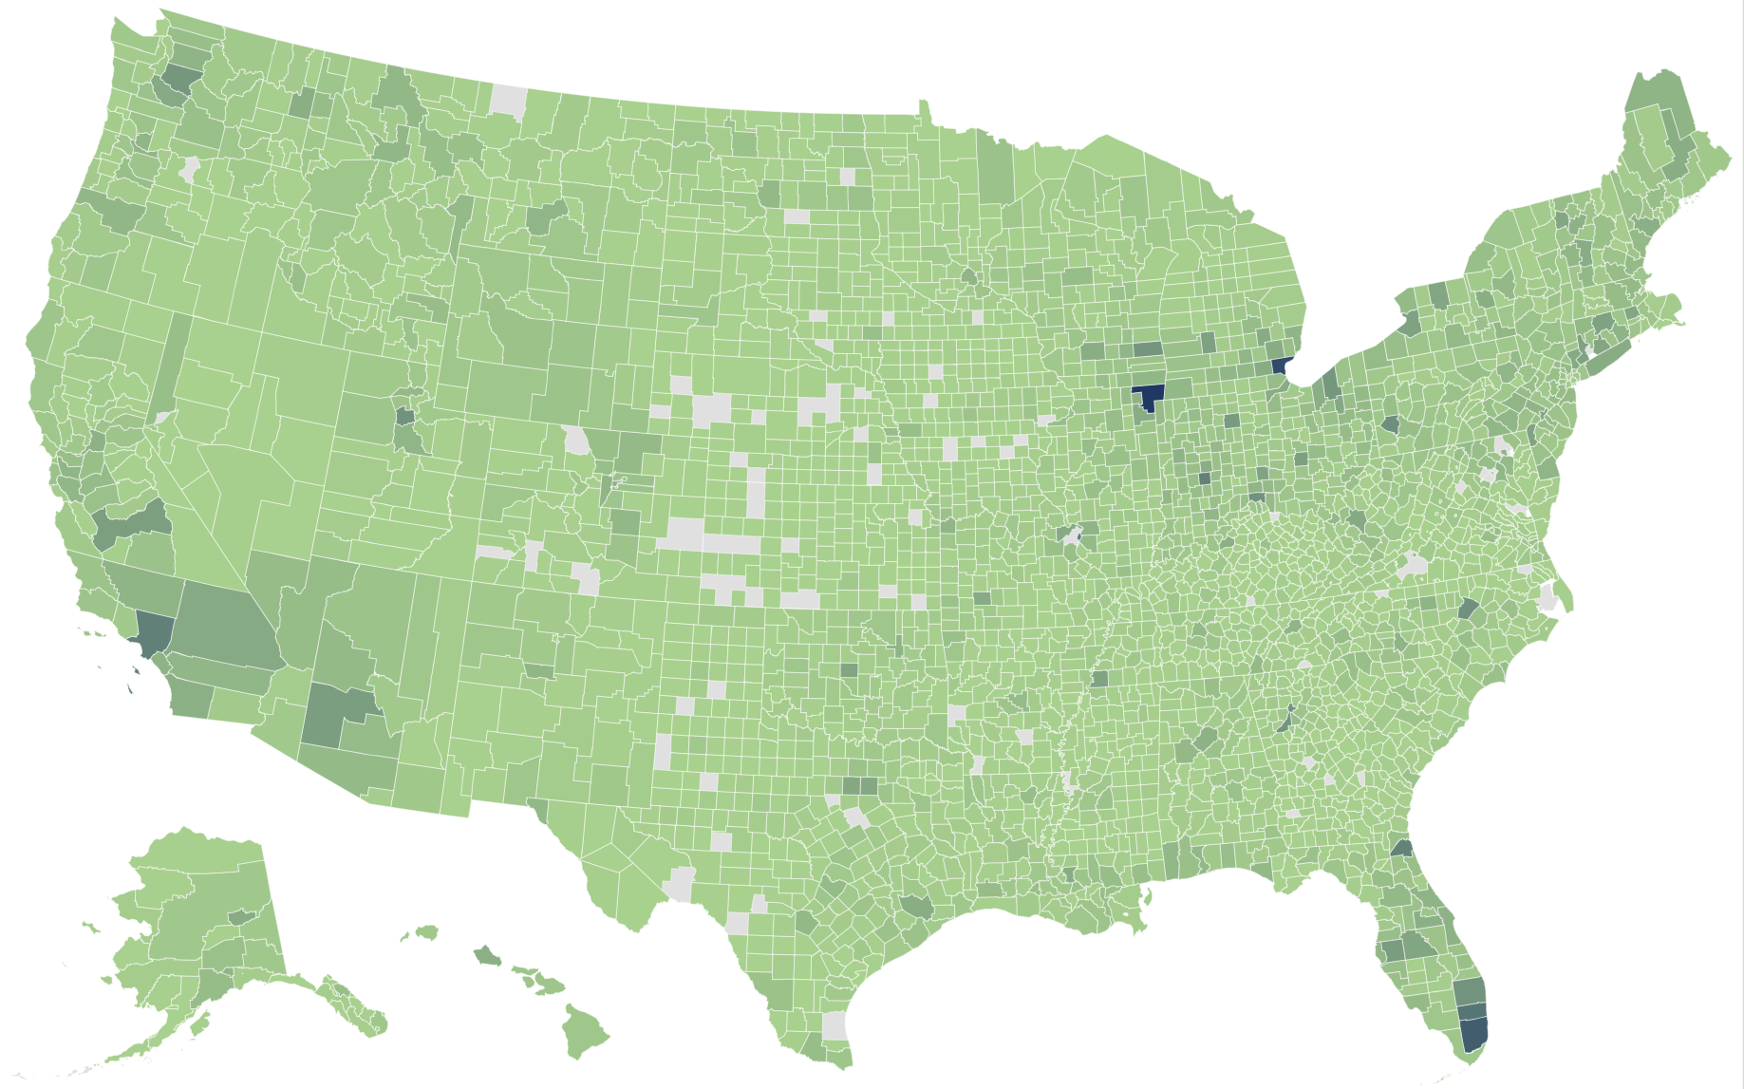
Location of New Project Commitments Supported by Infrastructure Investment & Jobs Act
Source: U.S. DOT data, does not include statewide projects.

Slide 26





Local Headlines
Show the Value of Infrastructure Investment
The deadliest interchange in Georgia is
getting a change that should save lives
“...the most important highway construction
project in literally, the history of our county.”
05/18/2022
Louisiana's Nelson Road extension
project is ‘game-changer’
Overdue roads project in southwest Omaha getting underway
“...a game-changer...will expand our
opportunities to host large-scale meetings.”
“...we’ve been working on this one for over a decade…
it’s time to build it.”
06/27/2023
09/05/2022
Highway 404 project to help reduce
crashes on New Mexico’s Anthony Gap
“...that area has been scary... I'm just really happy
that they're finally doing something about it...”
02/24/2023

Slide 27
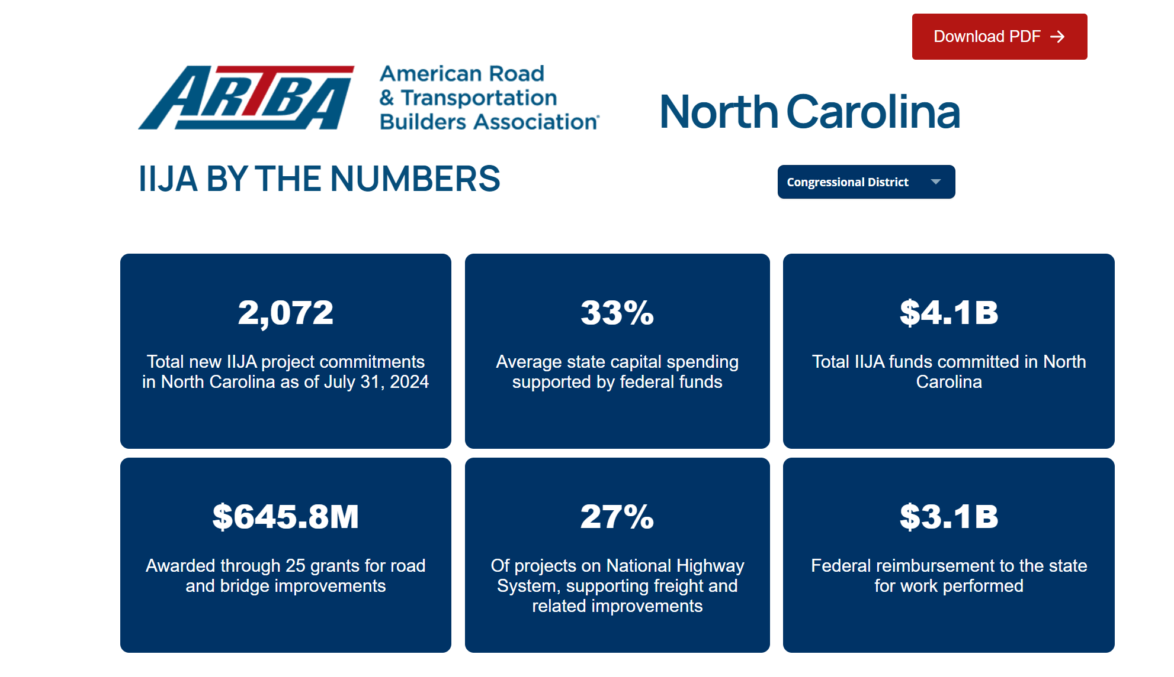
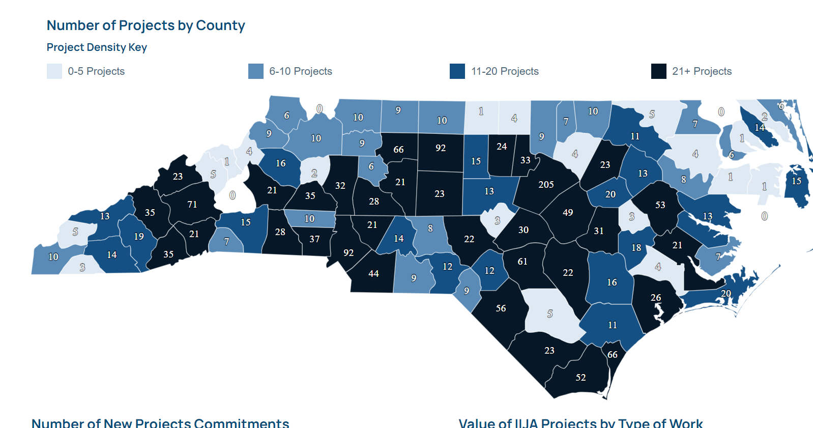
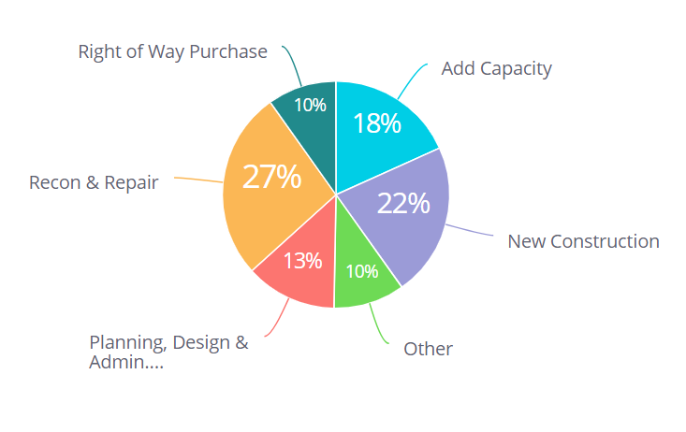
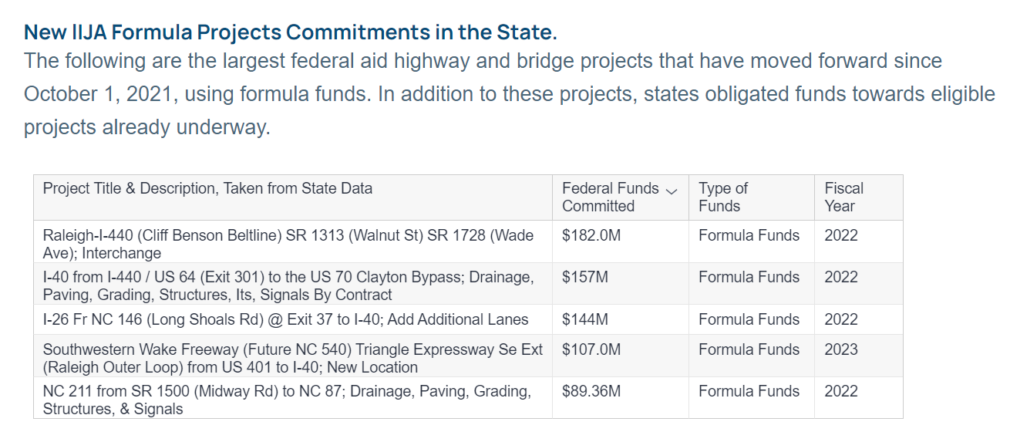
ARTBA Resources

Slide 28

Alison Premo Black ablack@artba.org
Josh Hurwitz jhurwitz@artba.org economics.artba.org

Slide 29

Any Questions?

Slide 30
Thank You!
Alison Premo Black, PhD
Senior Vice President & Chief Economist
American Road & Transportation Builders Association (ARTBA)

